Slide 1
Resource Concerns &
Soil Health Indicators
Notes:
Hi, This is State your name. I’m with the USDA’s Natural Resources Conservation Service and serve as the title…
Today were going to discuss Resource Concerns and Soil Health Indicators. This is Part of our Soil Health Continuing education series for conservation planners, farmers and agriculture professionals.

Slide 2
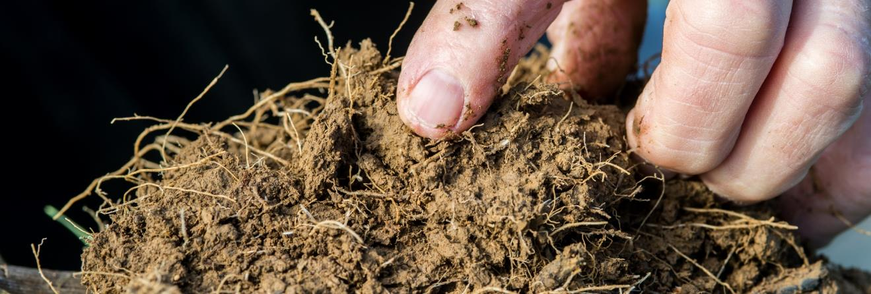
Objectives
Define and identify the soil health resource concerns and planning criteria that drive soil function
Review the use of the Cropland In-Field Soil Health Assessment Tool and others.
Locate and discuss the value and limitations to the soils data and interpretations that are currently available: WSS
Utilize planning criteria from CART to document Resource Concerns
Remsberg, SARE

Slide 3
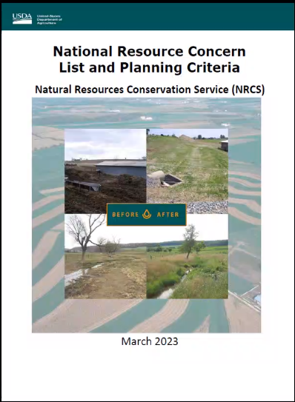
NRCS Resource Concerns
Resource Concern: An existing or expected degradation of the soil, water, air, plant, or animal resource base to the extent that the sustainability or intended use of the resource is impaired. (FOTG Section III)
Compaction
Organic matter depletion
Soil organism habitat loss or degradation
Aggregate instability
Notes:
The key soil health resource concerns are…, these can be root cause problems for many other resource concerns. These are tied to very important soil functions, so we are assessing indicators of loss of key soil functions

Slide 4
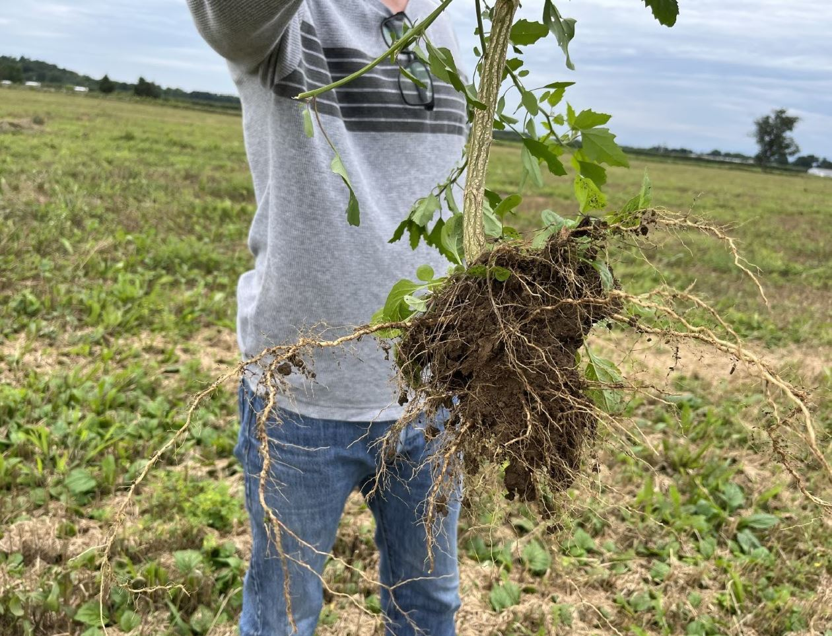
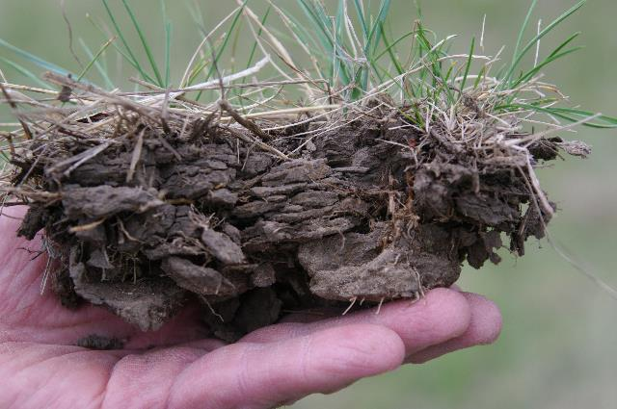
Compaction
Description: Management induced soil compaction at any level throughout the soil profile resulting in reduced rooting depth/structure, plant growth, biological activity, infiltration, etc.
Objective: No platy structure or restrictive layer, thickened or J-roots, or layers exceeding 300 psi at field capacity in the surface 0-8 inches.
Notes:
You may see some soil layering or platy type structure if it is impenetrable there’s an issue if its is friable then it is healing as a qualify for NO platy structure. Can be noticeable after soybeans or legumes. Also, Constant water table rising and falling may cause this issue. Some soils have inherent characteristics that may not be able to be over come. This needs to be a deviation from the natural soil structure.

Slide 5
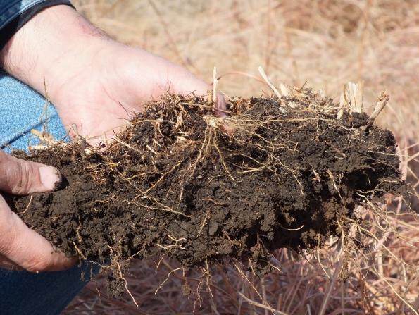
Soil Organism Habitat Loss or Degradation
Description: Quantity, quality, diversity or connectivity of food, cover, space, shelter and/or water is inadequate to meet requirements of beneficial soil organisms
Objective: Improve habitat for soil organisms, determined by monitoring several related indicators
Notes:
New in 2019

Slide 6
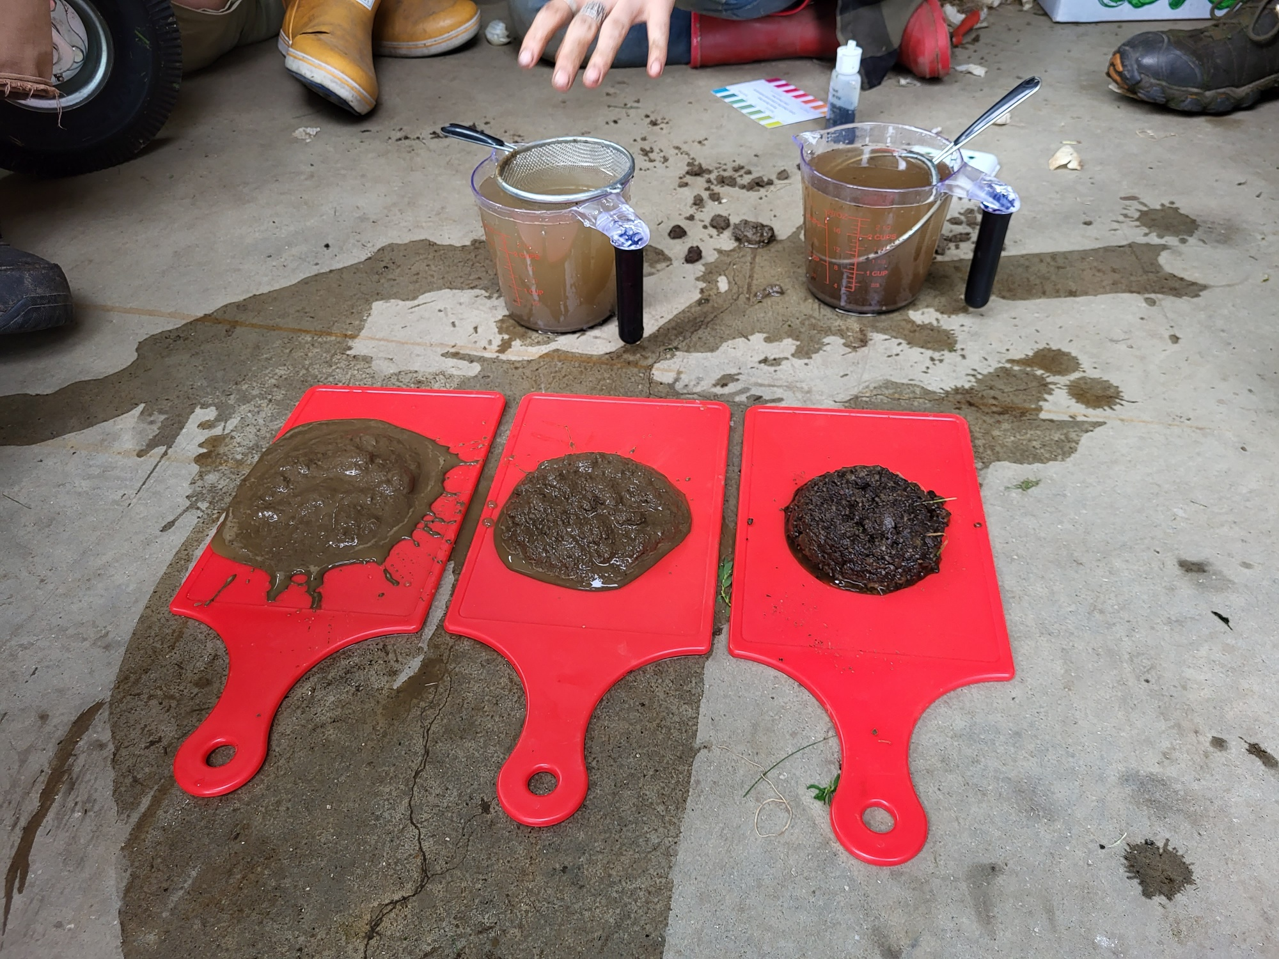
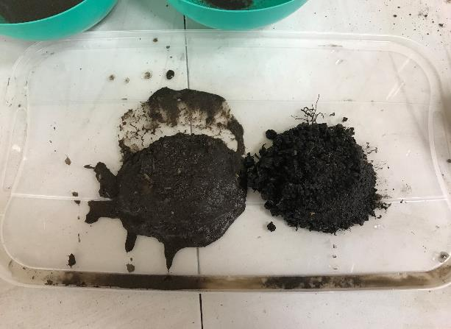
Aggregate Instability
Description: Management-induced degradation of water stable soil aggregates resulting in destabilized soil carbon; surface crusting; reduced water infiltration, water holding capacity, and aeration; depressed resilience to extreme weather; increased ponding and flooding; increased soil erosion and plant stress; and reduced habitat and soil biological activity.
Objective: Improved aggregate stability where water stable aggregates are present at critical levels and no evidence of poor aggregate stability, such as surface crusting, lack of soil structure.
Notes:
Dry aggregates can have high stability for wind erosion resistance just as well as wet aggregation helps resist erosion.

Slide 7
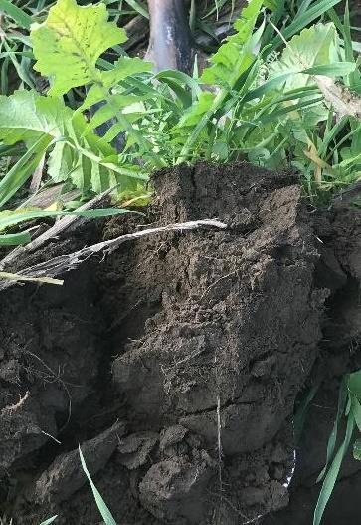
Cropland Assessment
Field visit
Interview producer/Management
Web Soil Survey and Conservation Assessment and Ranking Tool (CART)
Notes:
This assessment process is focused on cropland only
Field visit
In-Field soil health assessment
Interview producer/Management
Greatest influence on Soil Health resource concerns is management
Current producer concerns
Field/management history
WSS/CART
Inherent soil properties can reveal some vulnerabilities to resource concerns
Soil health interpretations- provide insight to the level of conservation needed to address resource concerns

Slide 8
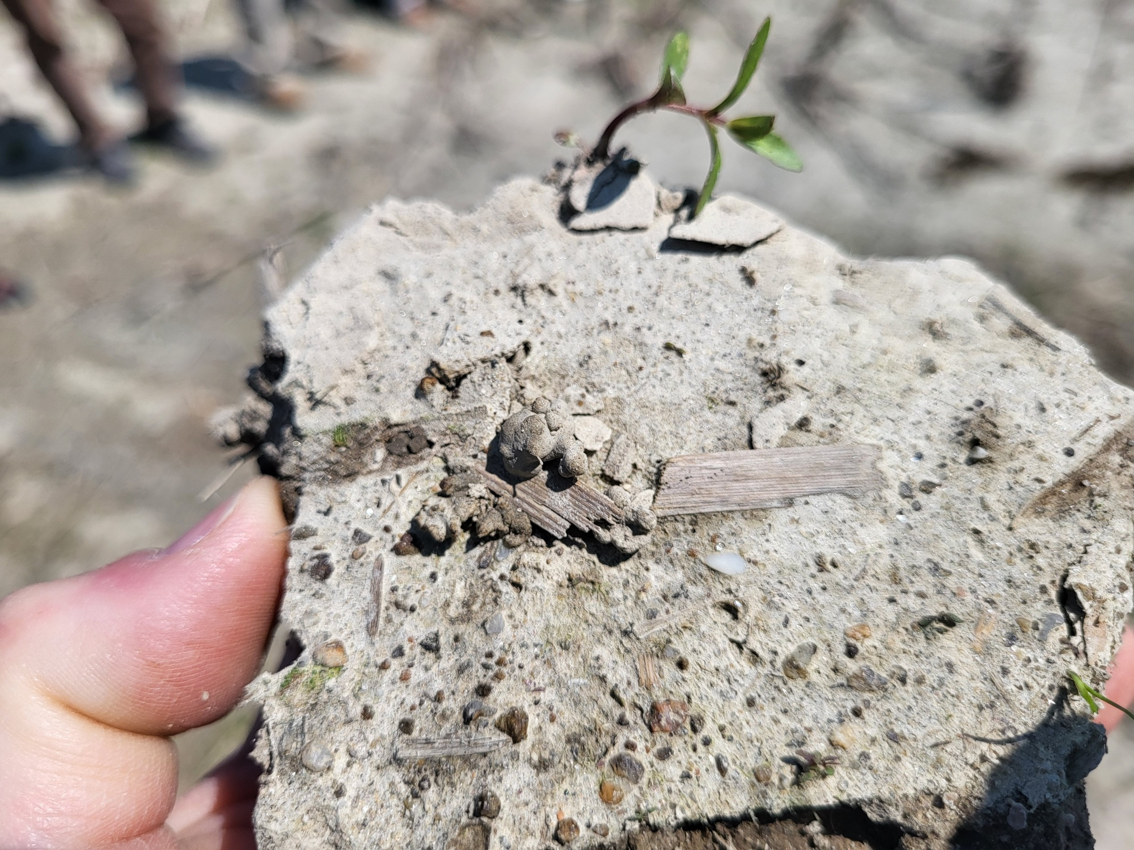
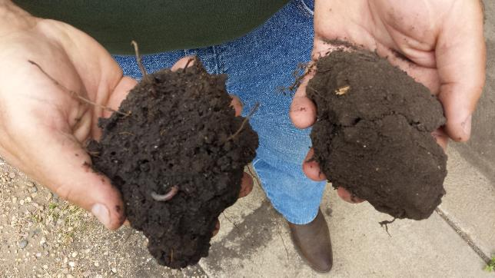
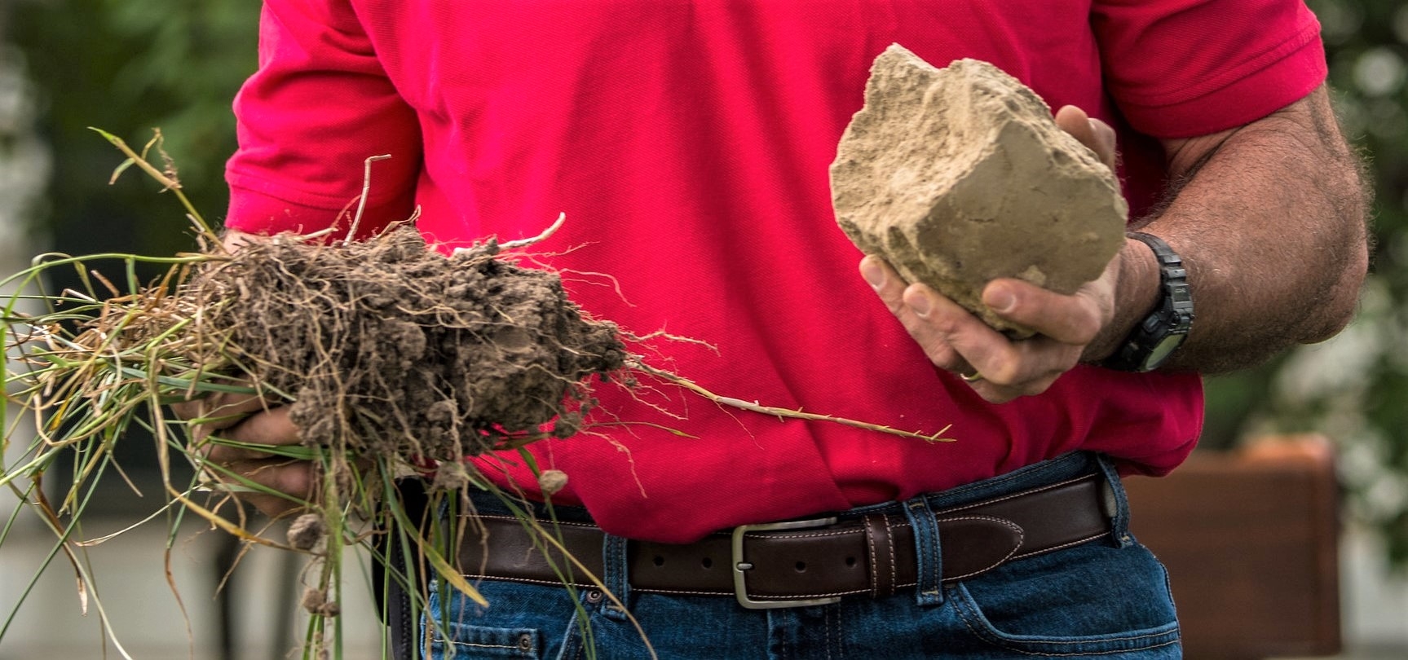
Organic Matter Depletion
Description: Management induced depletion of any or all soil organic matter pools resulting in limited soil function and processes that support: plant productivity, biological productivity; water/nutrient cycling.
Objective: Total organic matter or carbon is being monitored and increasing according to approved total organic matter or carbon soil test
Notes:
Possible potential pools (e.g., labile carbon, total soil carbon or nitrogen)
; habitat/food for soil organisms
Client input or Wind and water erosion soil conditioning index

Slide 9
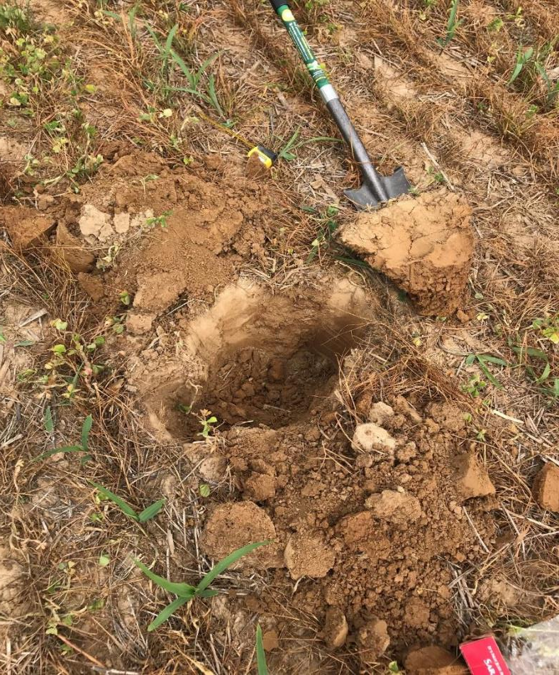
Tools of the trade
In-Field Assessment
Shovel
Knives
Water
Sink strainers
Infiltration rings
Notetaking
Camera
Color book
Phone: Land PKS or Survey 123
Notes:
[Picture can be changed to a local soil] In- field soil health assessments are an important first step to diagnose soil health resource concerns.

Slide 10
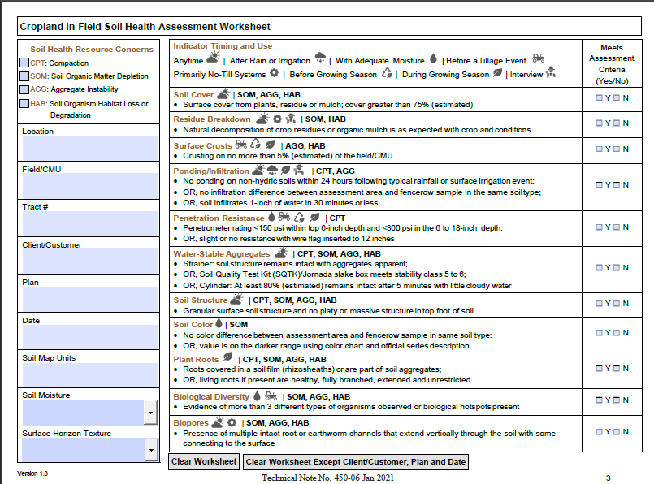
Notes:
* BE SURE TO HAVE THEM TAKE THIS OUT OF THEIR HANDOUT SECTION
The Cropland In-Field Soil Health Assessment is designed to be used as a diagnostic tool to help conservation planners determine if soil health resource concerns exist…not necessarily for comparing one field to another, or as a means of monitoring changes in a field over time, nor should it be assumed that it is a comprehensive assessment of all biological, physical, and chemical processes that are critical to soil function.
The first 5 indicators can be completed without having to even take a shovel out so they are completed with the producer got get good information if you can not visually discern anything.
Of the indicators 3 have all four resource concerns tied to them Water stable aggregates, Soil structure, and plant roots.

Slide 11
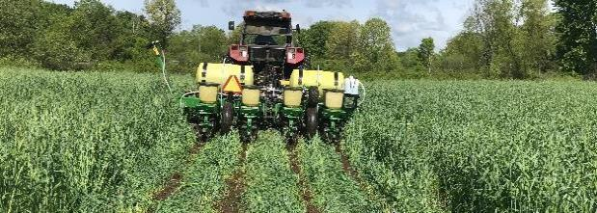
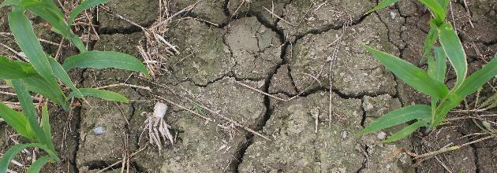
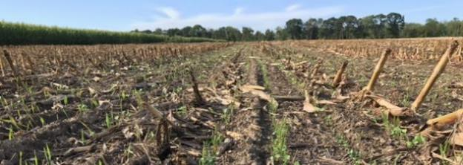
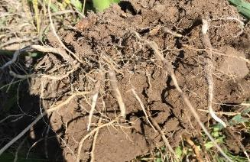
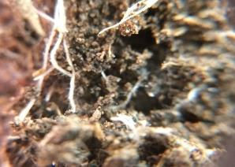
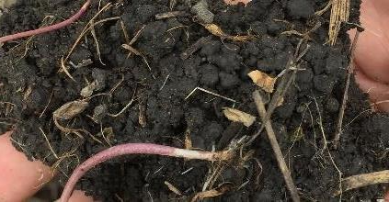
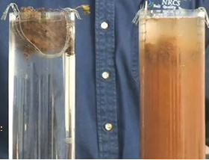
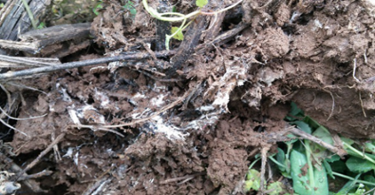
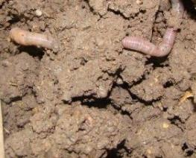
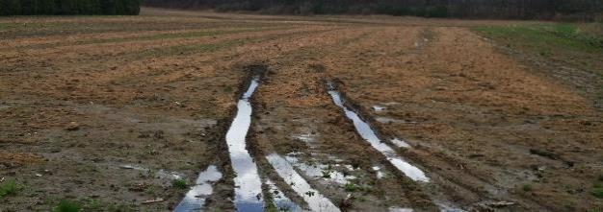
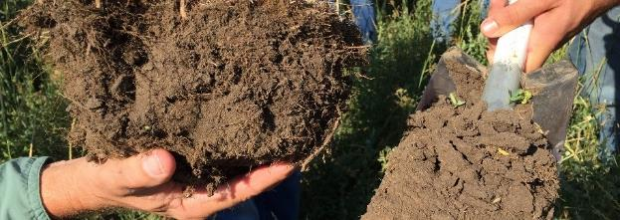
In-Field Soil Health Assessment To Identify Resource Concern Presence
Soil Cover
Surface Crusting
Residue Breakdown
Plant Roots & Pores
Aggregate Stability
Biological Activity
Penetration Resistance/
Soil Structure/ Ponding
Soil Color
Notes:
We’ll be diving into each of these field indicators a little more

Slide 12
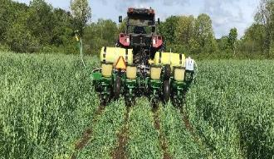
In-Field Assessment
Indicator: Soil Cover
Description | Soil cover is the percent of the soil surface that is covered by plant residue, organic mulch and/or live plants.
Resource Concerns Addressed | Aggregate instability Soil organism habitat loss or degradation | Soil organic matter depletion
In-field measurement | Farmer interview, Photo estimation method or state approved method, OR Line intercept: https://www.nrcs.usda.gov/sites/default/files/2022-10/Cropland_InField_Soil_Health_Assessment_Guide.pdf
Rating Criteria | Meets Criteria | Does Not Meet Criteria | Does Not Meet Criteria
 | Cover > 75% after planting | Cover < 75% after planting | Cover < 75% after planting
Notes:
Showcase these in the field.
Soil Cover Soil cover is the percent of the soil surface that is covered by plant residue, organic mulch and/or live plant. Lack of residue cover exposes the soil to erosion and detachment of soil particles from rain and reduces the food source for soil microbes. The C:N ratio and amount of residue will impact how long it will last before breakdown. Assessment is based on the amount of the soil surface covered by living plants or the residue of previous crops
High--Year round surface cover from plants, plant residue or mulch; cover 50% to 100% after planting
Medium -- Year round surface cover plants, plant residue or mulch; cover 30% to 50% after planting
Low -- Year round surface cover plants, plant residue or mulch; cover < 30% after planting

Slide 13
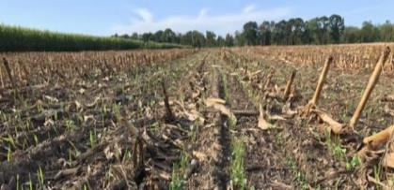
In-Field Assessment
Indicator: Residue Breakdown
Description | The rate at which residue decomposes is an indicator of relative biological activity; biological shredding, fragmenting, cycling or incorporating of previous crop residue.
Resource Concerns Addressed | Soil organism habitat loss or degradation | Soil organic matter depletion
In-field measurement | Look at existing residue cover for signs of breakdown, consider: If tillage present, then not applicable. How many seasons/layers of crop residue are present Residue composition and type (C:N) residue crops were grown Residue color and condition of most recent crop residue
Rating Criteria | Meets Criteria | Does Not Meet Criteria | Does Not Meet Criteria
 | Residue pieces are small, mixed in surface or minimal crop residue remaining from >1 cropping season | Cover < 75% after planting | Residue is in large pieces left after planting, can be handled without crumbling and/or significant residue from 2 or more cropping seasons is present
Notes:
Residue breakdown is the biological shredding, fragmenting, cycling or incorporating of previous crop residue. The rate at which residue decomposes is an indicator of relative biological activity. Residue breakdown will be assessed by gaging the age of previous residue and evidence of shredding, fragmenting and/or incorporating into soil without tillage
High—residue pieces are small, mixed in surface or minimal crop residue remaining from >1 cropping seasons
Medium—residue pieces are close to size left by harvest but crumble when handled or crop residue from 1-2 cropping season
Low – residue in large piece left after harvest, can be handled without crumbling with lots of residue from 2 or more cropping season
We don’t want to see brand new looking corn stalks from 2019 when we are planting corn the next time in 2021. It’s about how the corn stalks look, after one year, two years and three years

Slide 14
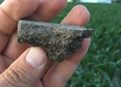
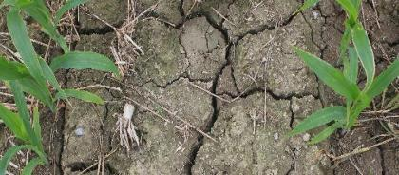
In-Field Assessment
Indicator: Surface Crusts
Description | Crusts form after rain or irrigation on soils with weak aggregate stability.
Resource Concerns Addressed | Aggregate instability | Soil organism habitat loss or degradation
In-field measurement | Evaluated by visual observation after rainfall/irrigation and drying: Note whether crusts are throughout the field or only in patches. Near surface will be dense, show layered sediment deposits Poor crop emergence uneven stand
Rating Criteria | Meets Criteria | Does Not Meet Criteria | Does Not Meet Criteria
 | Evidence of surface crust < 5% of field | Cover < 75% after planting | Evidence of surface crust > 5% of field
Notes:
Importance:
Reduces crop emergence
Decreases infiltration
Increases runoff and risk of ponding
Limits soil air and/or water exchange
Reduced water storage
Causes denitrification
Surface Crusting Crusts form after rain or irrigation on soils with poor aggregation. They can reduce infiltration, and plant emergence, and increase runoff. Crusts may also be prevalent from salinity.

Slide 15
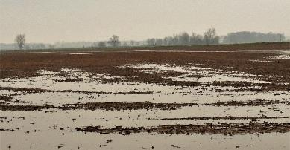
In-Field Assessment
Indicator: Ponding/Infiltration
Description | Areas of the field that collect and hold runoff water from other parts of the field.
Resource Concerns Addressed | Aggregate instability | Surface compaction
In-field measurement | Farmer interview or visual observation after rainfall/irrigation: Note evidence of crop residue deposits Evidence of ponding from observation or on recent aerial photos Poor crop conditions (yellowing) Soil infiltrates 1-inch of water in 30 minutes or less
Rating Criteria | Meets Criteria | Does Not Meet Criteria | Does Not Meet Criteria
 | Evidence of ponding 24 hours or less after a typical rain event; 1-inch water infiltrates < 30 min. | Cover < 75% after planting | Evidence of ponding more than 24 hours after a rain event; 1-inch of water takes > 30 min. to infiltrate
Notes:
Importance:
Causes denitrification
Delays planting or harvest
Limits soil air exchange
Increases transport of contaminants to tile or ground water through preferential flow.
Ponding is often thought to be a sure indicator of compaction; however it is just a likely to be loss of aggregate stability and sometimes both. Poor infiltration from poor aggregate stability on the majority of the field usually results in extra runoff water ponding in the lowest parts of the field.

Slide 16
In-Field Assessment
Indicator: Penetration Resistance
Description | Management induced reduction of large pores and degraded structure (i.e., platy) that results in decreased rooting depth, plant growth and soil biological habitat and activity in the upper eight to twelve inches of soil.
Resource Concerns Addressed | Compaction
In-field measurement | Conduct with soil moisture near field capacity: Evaluate multiple representative locations in the field Record depths of restrictive layer(s) & PSI readings (penetrometer) a wire flag can be used in place of the penetrometer Evaluate root development and distribution Look for platy structure: dig a and look for platy non-friable stucure
Rating Criteria | Meets Criteria | Does Not Meet Criteria | Does Not Meet Criteria
 | Granular structure, appropriate PSI reading, vertical channels or roots. | Cover < 75% after planting | Evidence of platy structure, unacceptable PSI, root restriction, surface ponding, horizontal or abnormal root architecture.
Notes:
This one can be misleading as many cropland and grazed soils may have a dense layer that is detected with a probe or shovel. It is always best to confirm that it is a resource concern, by checking more than one indicator (e.g.- platy structure).

Slide 17
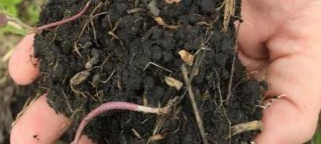
In-Field Assessment
Indicator: Aggregate Stability
Description | Soil aggregate stability is related to soil porosity and how well a soil can resist raindrop impact and erosion.
Resource Concerns Addressed | Aggregate instability Soil organism habitat loss or degradation | Soil organic matter depletion Surface compaction
In-field measurement | Choose one of the following three methods: Slake test (ensure samples are completely dry) Strainer test (soil slump) Jornada soil aggregate stability test (stability kit) or bottle cap method
Rating Criteria | Meets Criteria | Does Not Meet Criteria | Does Not Meet Criteria
 | Aggregates remain intact ≥80% for slake test “stands up” for slump test, runoff water is translucent Jornada criteria (rating 5-6) | Cover < 75% after planting | Aggregate disintegrates <80% remaining (slake) Soil “slumps” into a puddle, runoff is not translucent Jornada criteria (rating < 5)
Notes:
Importance:
Improves soil air and water exchange (pore space) and water storage
Resists erosive forces of wind & water
Decreases risk of ponding and runoff; increases infiltration
Increases microbial habitat, activity, and nutrient cycling
For some of the Mollisols or dark prairie soils smaller aggregates may break off in the slake test, but as long as they don’t break into individual soil particles (sand, silt and clay) and cloud up the water, then the aggregates are still stable.

Slide 18
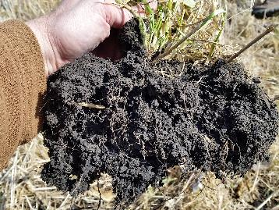

In-Field Assessment
Indicator: Soil Structure
Description | Soil structure is the arrangement of soil particles in various aggregates differing in shape, size, stability, and degree of adhesion to one another.
Resource Concerns Addressed | Aggregate instability Soil organism habitat loss or degradation | Soil organic matter depletion Surface compaction
In-field measurement | Observe soil structure and compare to the official series description.
Rating Criteria | Meets Criteria | Does Not Meet Criteria | Does Not Meet Criteria
 | Granular structure in the surface, or structure is as described in the official series description | Cover < 75% after planting | Platy or massive structure, or structure does not match the description in the official series description
Notes:
Granular is preferred, but don’t confuse this with just freshly worked ground. True granular soil aggregates are still water and wind stable (as above). Platy structure is generally caused by excessive weight or traffic.

Slide 19
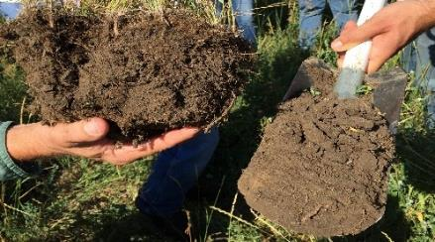
In-Field Assessment
Indicator: Soil Color
Description | Soil color is used as an indicator of loss or accumulation of organic matter.
Resource Concerns Addressed | Soil Organic Matter Depletion
In-field measurement | Use soil color chart/book and compare to official series description, or compare surface soil to an undisturbed area nearby.
Rating Criteria | Meets Criteria | Does Not Meet Criteria | Does Not Meet Criteria
 | An obvious darker surface layer; similar to official series description value (OSD) | Cover < 75% after planting | Lighter than OSD; soil mixing observed and/or surface is lighter in color than the horizon below
*Note soil moisture makes soil appear darker and should be noted if comparing different fields
Notes:
Color can be difficult to evaluate unless there is a native or long-term undisturbed site close by. Generally if the surface is lighter than what is described in the soil survey or the surface is lighter that the horizon below then resource concerns are likely.

Slide 20

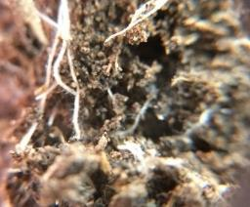
In-Field Assessment
Indicator: Plant Roots and Biopores (continuity)
Description | Roots influence the soil immediately adjacent to them through exudates, growing and leaving soil organic matter as they die.
Resource Concerns Addressed | Aggregate instability Soil organism habitat loss or degradation | Soil organic matter depletion Compaction (Plant Roots)
In-field measurement | Observe evidence of dark root channels or biopores left by previous plants or earthworms.
Rating Criteria | Meets Criteria | Does Not Meet Criteria | Does Not Meet Criteria
 | Presence of dark root channels or biopores left by previous plants or earthworms; roots healthy, branched, extended, with rhizosheaths | Cover < 75% after planting | Roots are stressed and do not follow previous root channels, no pores evident from earthworms
Notes:
Importance:
Release exudates to stimulate microbes and form aggregates and soil organic matter
Biopores are channels that remain from season to season and are often areas of organic carbon concentration, plant nutrients, and biological activity
Increases aeration, infiltration, drainage, and water storage and availability

Slide 21

In-Field Assessment
Indicator: Biological Diversity
Description | Presence and relative abundance of earthworms, mites, springtails, millipedes, roundworms, beetles, termites, fungal hyphae and other organisms provide evidence of a healthy soil ecosystem.
Resource Concerns Addressed | Aggregate instability Soil organism habitat loss or degradation | Soil organic matter depletion
In-field measurement | Look for evidence of soil organisms (e.g., earthworm casts, middens, large pores, active nodules, insects, fungal hyphae, etc.).
Rating Criteria | Meets Criteria | Does Not Meet Criteria | Does Not Meet Criteria
 | Clearly evident: more than 3 types of organisms observed | Cover < 75% after planting | No biological activity visible, lacking earthworms, no saprophytic fungi, low to no evidence of macrofauna
Notes:
Importance:
Diverse population supports numerous ecosystem functions
Involved in aggregation and SOM formation
Nutrient cycling, disease suppression, detoxification
3 types of non invasive or predatory to plant species.
A good resource is the Farming with soil life https://www.sare.org/news/new-book-farming-with-soil-life-a-handbook-for-supporting-soil-invertebrates-and-soil-health-on-farms/?highlight=farming+with+soil+life By Xerces.

Slide 22
Compaction Resource Concern Decision Tree
Select RC or not
Check No
Compaction RC
Ponding/Infiltration
Yes
Penetration Resistance
Is surface soil platy OR do 2 or more indicators not meet assessment criteria?
Water-stable Aggregates
Soil Structure
No Compaction RC
Plant Roots
No

Slide 23
Soil Organism Habitat Loss or Degradation Resource Concern Decision Tree
Check No
Soil Cover
Select RC or not
Soil Organism RC
Residue Breakdown
Surface Crusts
Yes
Water-stable Aggregates
Do 2 or more indicators not meet assessment criteria?
Soil Structure
No Soil Organism
RC
Plant Roots
No
Biological Diversity
Biopores

Slide 24
Soil Organic Matter Depletion Resource Concern Decision Tree
Check No
Soil Cover
Select RC or not
SOM Depletion RC
Residue Breakdown
Water-stable Aggregates
Yes
Soil Structure
Do 3 or more indicators not meet assessment criteria?
Soil Color
No SOM Depletion
RC
Plant Roots
No
Biological Diversity
Biopores

Slide 25
Aggregate Stability Resource Concern Decision Tree
Check No
Soil Cover
Select RC or not
Aggregate Instability RC
Surface Crusts
Yes
Ponding/Infiltration
Is aggregate instability prevalent OR do 2 or more indicators not meet assessment criteria?
Water-stable Aggregates
Soil Structure
Plant Roots
No Aggregate Instability
RC
No
Biological Diversity
Biopores

Slide 26
Rifsha an Fifsha pifsha

Slide 27

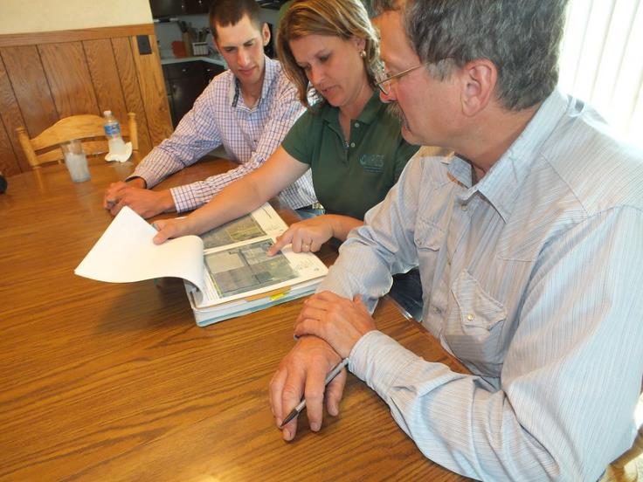
WSS/CART

Slide 28
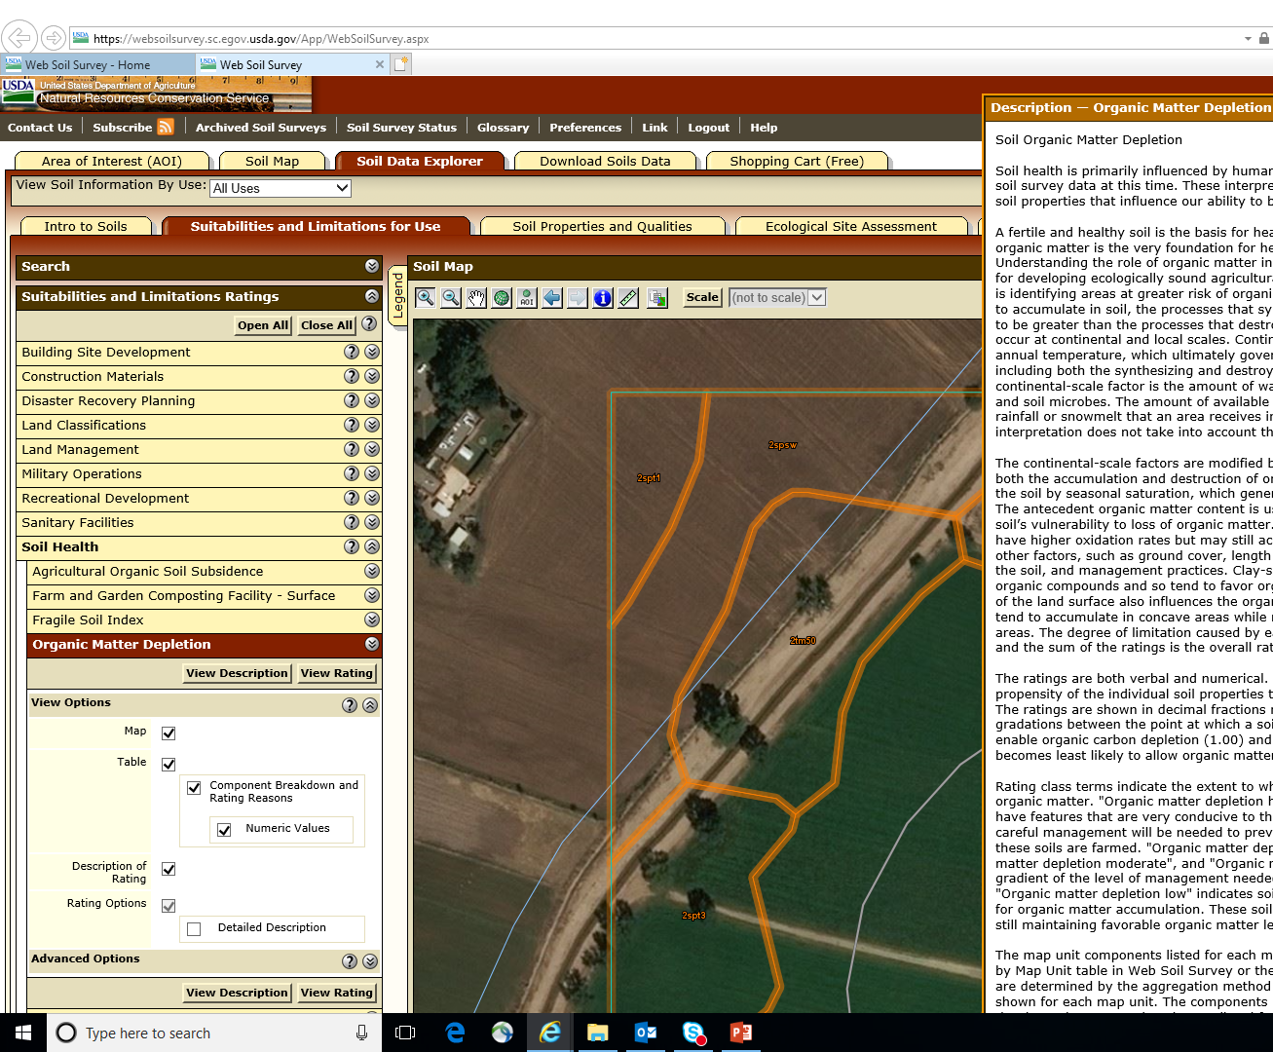
Limitations to Soil Health Interpretations: They represent a soil’s vulnerability based on inherent properties, but management is the primary driver of whether the resource concern is present. Need site-specific information on cropping systems to properly assess soil health/indicators/interpretations (e.g., crop rotations, cover crops, irrigation system, irrigation water quality, soil stratification, soil texture, fertility, tillage, grazing, etc.)
Notes:
Web Soil Survey does have soil health interpretations. If your planner is looking for information on a field they can develop maps of suitability's and limitations for a producer or for their casefile. You can look up soil organism habitat, soil organic matter depletion, biochar, aggerate stability for example.
Inherent properties: properties that occur naturally and cannot be impacted/changed by management (e.g., texture, parent material, etc.)
Dynamic properties: soil properties that can be influenced/changed as a result of management (e.g., structure, color, pH, organic matter, biological community structure/composition, etc.)

Slide 29
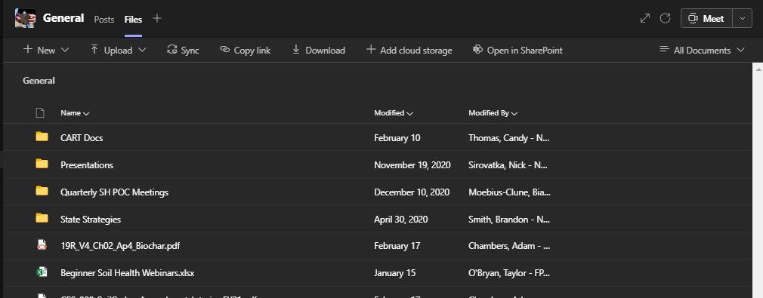
CART
Guidance Available
Document for Supplemental Guidance for Soil Health Resource Concerns in CART is available in Teams- NRCS Soil Health Team- Files - CART Docs. It references the CART Manual- CART Version 3.0 And 2021 CART HELP Guide , the memo sent on 1/28/21, and the Most recent version of the IFSHA ver. 1.4 Jan. 2021, Survey 123 instructions
CART Resource Concern Assessment Document Version 3
2021 Supplemental Guidance for Soil Health Assessment in CART
Notes:
We have a supplemental guidance document available
This can be made available to FO staff or be used by State Specialists who are developing state guidelines for CART

Slide 30
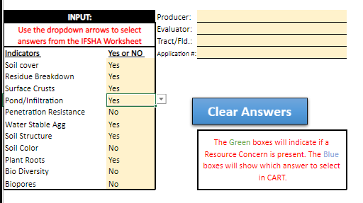
CART Help Doc.
Notes:
From the IFSHA you will take your Yes results and no results and select the appropriate option from the dropdown.

Slide 31
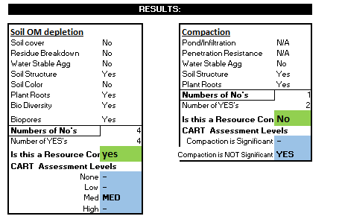
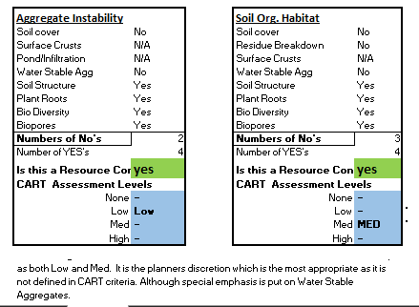
Cart Help Doc.
Notes:
What the yes and no’s do is gives you the answer to whether you have a RC or not and also provides the Cart Assessment level that comes from the number of yes responses you have on the infield soil health assessment.

Slide 32
CART DEMO
Bring in Cart Expert to demonstrate how to select the appropriate RC given a completed IFSHA
Notes:
Fill out an iFsha from a field you know of or just make it up and bring in your CART Expert/planner. Who can take the infield and go through and document

Slide 33
Following slides are optional to slide 40

Slide 34
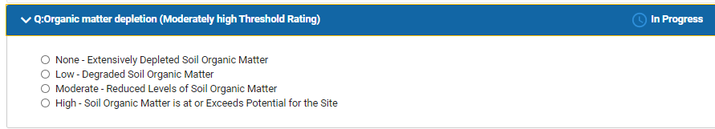
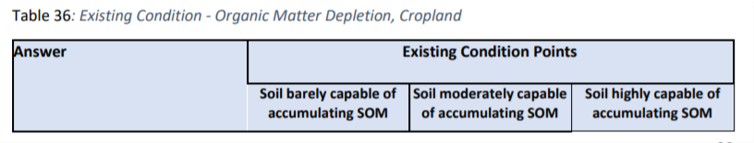
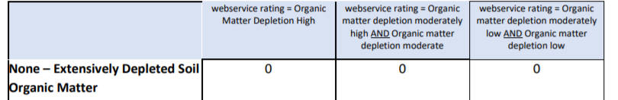
CART
Organic Matter Depletion
Notes:
Here is where after the planner designated the RC and a Web service report will determine the level. High Level will exceed threshold without any additional practices needed. On the web services after indicating it could be an RC.
IN the next three RC’s is where the IFSHA is required to meet the level. In Table 36 you need to answer yes to a set number of indicators.
Other practices may be required to meet the level below generally,
None= 2 or less indicators
Low=3 Indicators
Med= 4 Indicators
High= 5 or more Indicators

Slide 35
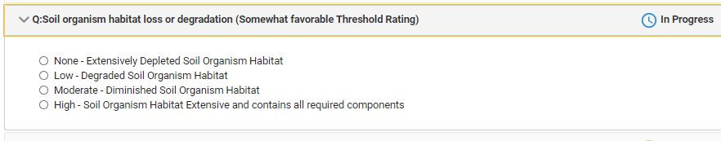

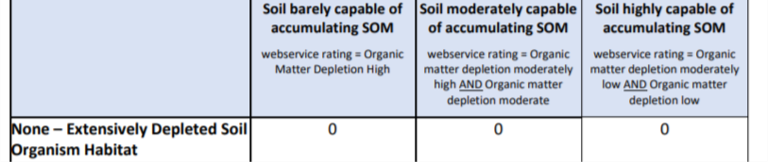

CART
Soil Organism Habitat Degradation
Notes:
High Level will exceed threshold without any additional practices needed. On the web services after indicating it could be an RC.
In table 43 the planner after designating this as an RC will utilize the IFSHA, if you answer yes to the following indicators.
None= 1 or less indicators
Low=2-3 Indicators
Med= 3-4 Indicators
High= 4 or more Indicators- INCLUDING Water stable Aggregates

Slide 36
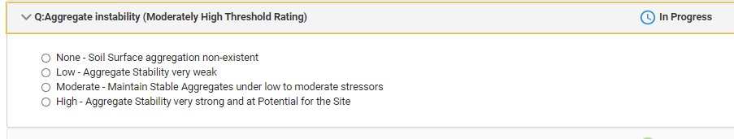
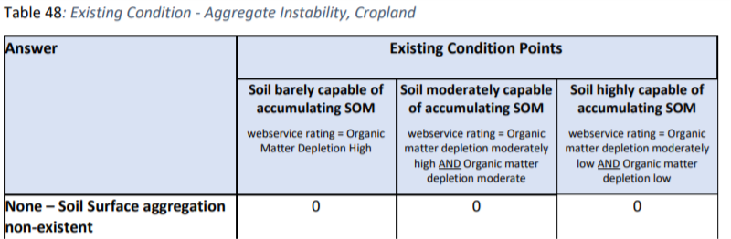
CART
Aggregate Instability
Notes:
High Level will exceed threshold without any additional practices needed. On the web services after indicating it could be an RC.
None= 0 indicators
Low=1-2 Indicators- and NO to Water stable aggregates
Med= 2 or more Indicators- INCLUDING Water stable Aggregates
High= 3 or more Indicators- INCLUDING Water stable Aggregates

Slide 37
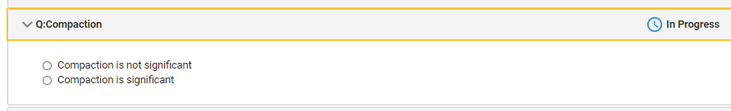
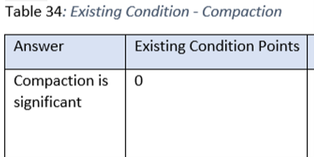
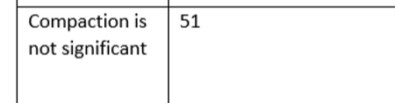
CART
Compaction
Notes:
Initially web services will determine if you meet the threshold or not given the soil on the field after you make a designation of a potential RC. Then you must document existing practices, CART will let you know if you need more practices to meet the threshold in this case
Answer Compaction is NOT significant will exceed threshold without any additional practices needed.

Slide 38
CART
Systems Approach to Cart Ranking
An example for Organic Matter Depletion Threshold level needed -51:
Conservation Crop Rotation – 10
Cover Crop - 15
Residue and Tillage Management, No-till – 25
Nutrient Management - 10
A system using 328,329, 340 and 590 will get 60 pts. Using 345 or Strip Till is slightly less; but adding 336 (soil carbon amendment) will go much higher above the threshold.
Notes:
The practice narrative points were set up to help the planner over come threshold levels by adopting a soil health management systems. So in this example the threshold level was 51. With existing practices they may not meet the level of 51 but a system using 328, 329, 340 and 590 will achieve 60 points which would put you over the threshold limit.

Slide 39
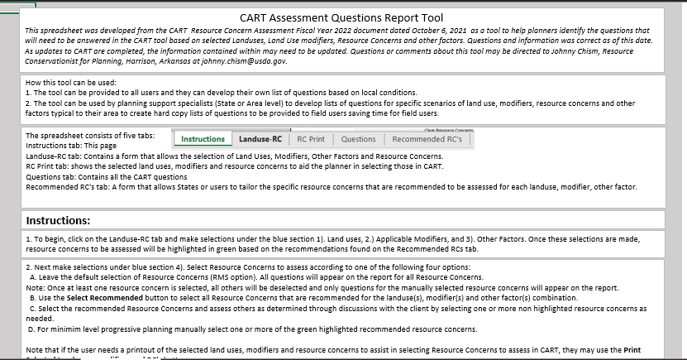
CART Issues
Hover Text is incorrect will be fixed for FY23
CART Assessment Questions Report Tool inaccurately accounts for each RC except for compaction
Agg Stab--Missing roots and biological diversity
SOM Depletion—missing soil color
Compaction-ok
SOHL – missing Crusts
Notes:
There are some discrepancies in the tool in the hover text. Some of the indicators have been combined in the hover text. If you ignore that text you can select the correct number of questions that you answered yes to on page one and answer the tool appropriately. If you count the indicators in the hover text they are incorrect as is the CART assessment questions report tool that was sent out as a guide to the states from the CART training team and therefore has resulted in many overrides if the planner has paid attention to the question. In some states that CART assement question tool is being used for QAR purposes so be careful and document in the casefile what you did and why on your IFSHA

Slide 40


Survey 123
Georeferenced IFSHA
Resource concerns documented
CART category determined: none, low, medium, High
Note taking and photo capability
Notes:
Survey 123 is a free application that can be downloaded to your GOV or personal smart phone. You can do the same thing you did on the IFSHA worksheet as you do here. This app will allow you to geo reference where you did the IFHSA, you can take photos, you can post photos and save it. IT will also tell you if you have a resource concern and what threshold level or row on table 36,43 and 48 from the CART instructions that are given to each state. There is also Land PKS which requires a phone connection to work and does everything but the CART options that you find on the IFSHA.

Slide 41

This information is provided as a public service and constitutes no endorsement by the United States Department of Agriculture or the Natural Resources Conservation Service of any service, supply, or equipment listed.
While an effort has been made to provide a complete and accurate listing of services, supplies, and equipment, omissions or other errors may occur and, therefore, other available sources of information should be consulted
The USDA is an equal opportunity provider and employer.
Meeh, NRCS

Slide 42
EXTRA SLIDES
INCASE OF INCLEMENT WEATHER SLIDES BELOW CAN BE USED IF YOU CAN’T GO TO THE FIELD.

Slide 43

A field of seed corn stubble just before planting soybean
Notes:
[Picture can be changed to a more local representation] As with other resource concerns, it is impossible to be at every field right after planning so the planner’s professional judgement with information from farmer input on management will be needed.

Slide 44


Residue
Breakdown
Natural shredding and decomposition of residues
Don’t want a corn stalk to see its 3rd birthday
Biological activity
C:N Ratios
Nutrient cycling
Notes:
[Picture can be changed to a more local representation] we don’t want to see brand new looking corn stalks from 2019 when we are planting corn the next time in 2021. It’s about how the corn stalks look, after one year, two years and three years

Slide 45




Indicator: Surface Crusts
Notes:
[Pictures can be changed to a more local representation] Surface Crusting Crusts form after rain or irrigation on soils with poor aggregation. They can reduce infiltration, and plant emergence, and increase runoff.

Slide 46


Indicator: Penetration Resistance
UW- Extension https://www.youtube.com/watch?v=Zq_785JqRq8
Notes:
[Picture on right can be changed to a more local representation or slide can be hidden] https://www.youtube.com/watch?v=Zq_785JqRq8

Slide 47



Manage for Water Stable Aggregates
You want this…
NOT this!
Notes:
[Pictures on right can be changed to a more local representation] Photos showing this is what I want-shovel photo. And from the hand held soils.
Manage for the Biological organisms, to form Wet Stable Aggregates, to increase water infiltration, drainage and aeration and to build Soil Organic Matter.

Slide 48

Slake test
Notes:
[Pictures on right can be changed to a more local representation] The presence of water stable aggregates may be the most important soil health indicator especially at the soil surface which is the interface of soil, water and air. Cloudy water indicates the soil, with weak aggregate stability, is breaking down and releasing individual sand, silt and clay particle into the water. For some of the Mollisols or dark prairie soils (on the left) smaller aggregates may break off in the slake test, but as long as they don’t break into individual soil particles (sand, silt and clay) and cloud up the water, then the aggregates are still stable.

Slide 49




Slump Test
Notes:
[Pictures on right can be changed to a more local representation] Soil with low aggregate stability will have the consistency of pudding or peanut butter and soils with good aggregate stability will have the consistency of cake so that even when wet the soil aggregates and pores are intact.

Slide 50


Soil Structure
Notes:
[Pictures on right can be changed to a more local representation] Can you “see” the difference?

Slide 51






Indicators: Roots and Biopores
Rye Root, Soybean root and earthworm sharing the same biopore
Notes:
[Pictures on right can be changed to a more local representation] Roots are unrestricted and show continuity of rhizosphere and/ or biopores (drillosphere) from crop to crop.
Soil that clings tightly to the roots (especially on AMF host plants) are indicators of a healthy rhizosphere (exception.- non-hosts for AMF e.g.-brassicas).

Slide 52

Biological Diversity
Notes:
Earthworms can be a KEYSTONE CREATURE!
Great benefits:
burying and shredding plant residue which helps with the breakup of the previous year’s crops.
mix and aggregate soil
cycle nutrients
stimulate microbial activity.
However, an increase in earthworms doesn’t always mean all is well in the ecosystem.
Earthworm are tolerant to many chemistries
Check for other organisms to verify diversity

